Slide 1
Object Recognition Performance Dashboard
Data Analytics
June 2018

Slide 2
Project Team
Anselmo Jr Garza
Alfonso Moreno
Alán Dávila

Slide 3
The problem we look to solve
Determine the performance of an object recognition neural network pre-trained model’s visually and quantitatively.
The user provides the images. We show the model’s performance
This is the first step to determine if the model will be useful to label the user’s images and if more training is needed.

Slide 4
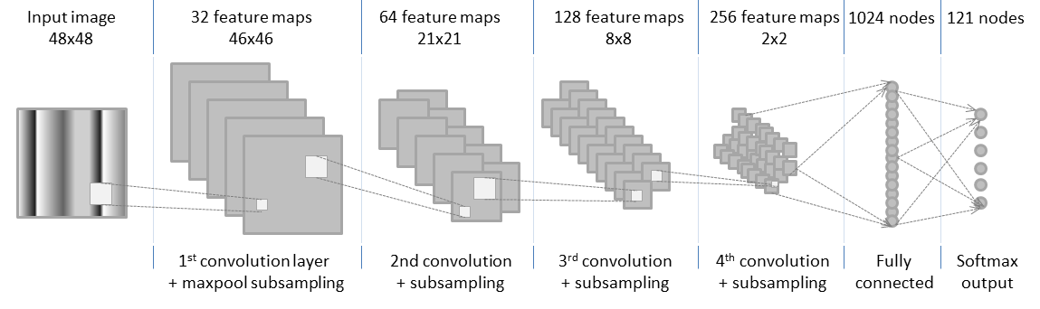
A, B, C of object recognition
Neural Network

Slide 5
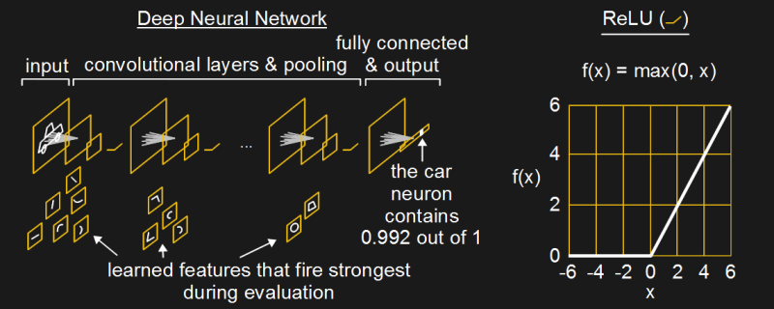
A, B, C of object recognition
Neural Network
https://hackaday.com/2017/06/08/from-50s-perceptrons-to-the-freaky-stuff-were-doing-today/

Slide 6
A, B, C of object recognition
Transfer learning
Leave as is
Train

Slide 7
A, B, C of object recognition
Step one of transfer learning: Try model on your images
Model might have been trained on:
Cars,
Vegetables,
People,
Chairs,
…..
But you actually want to classify:
Toyotas,
Apples,
Male/Female,
Sofa,
…..

Slide 8







Application architecture
Back-end
Front-end
Deployment

